Slide 1
Analysis and prediction of ADULT INCOMES IN US
Based on Census Income using Machine learning
By
Venu Kolli
Pratik Magar
Rashmi Mallappa

Slide 2
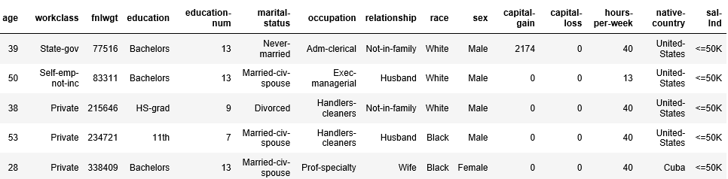
Dataset
Response Variable – SALARY OF ADULT (>50K or <=50K)
Predictor Variables: Demographics of Adult(age, education, sex, work hours, marital-status etc.,)
Binary classification problem

Slide 3

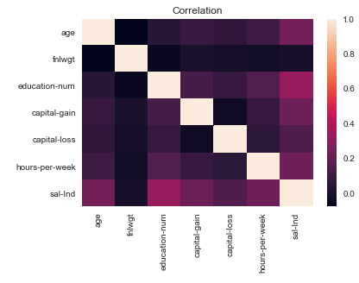
Data Pre-processing
Handling null values and outliers.
One-hot-encoding or creating dummy variables for categorical variables.
Co-relation Matrix

Slide 4
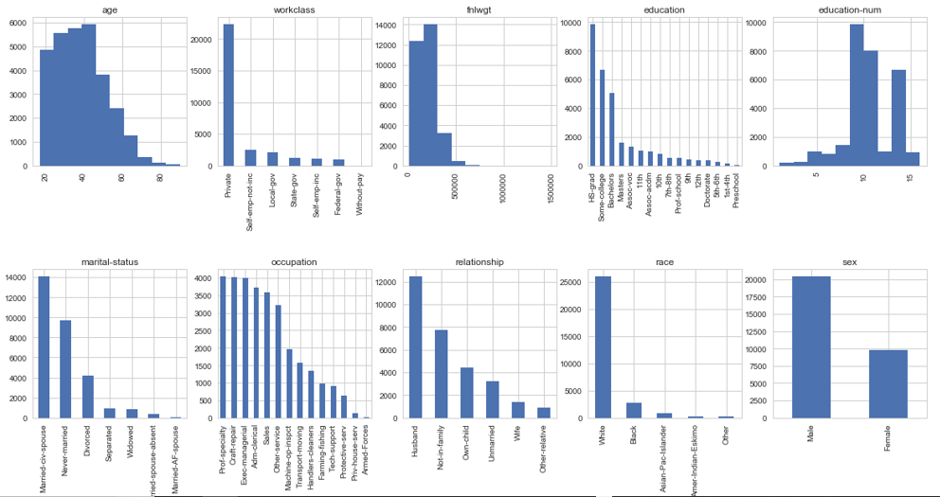
Visualization of DATA

Slide 5
Feature Selection
Recursive Feature Elimination - the importance of each feature is obtained either through a coef_ attribute or through a feature_importances_ attribute recursively.
Train and Test Data set :
Training Data = 75%
Test Data = 25%

Slide 6
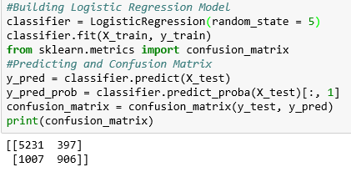
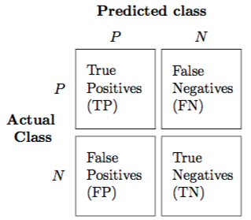
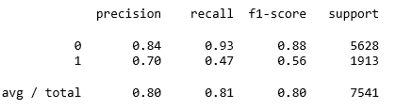
Logistic Regression model
Logistic regression as a special case of linear regression when the outcome variable is categorical
Predicts the probability of occurrence of an event by fitting data to a logit function.
Accuracy of logistic regression classifier on test set: 0.81
Recall: Recall gives us an idea about when it’s actually yes, how often does it predict yes.
Precision: Precision tells us about when it predicts yes, how often is it correct.

Slide 7
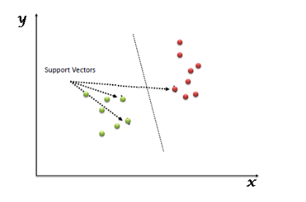
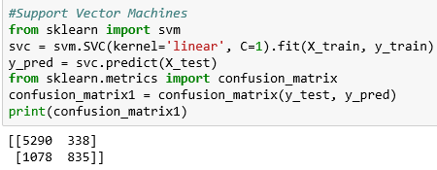
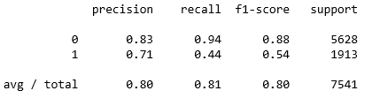
SUPPORT VECTOR CLASSIFIER
1.Plot each data item as a point in n-dimensional space
2.Perform classification by finding the hyper-plane that differentiate the two classes very well
Accuracy of SVM classifier on test set: 0.81

Slide 8
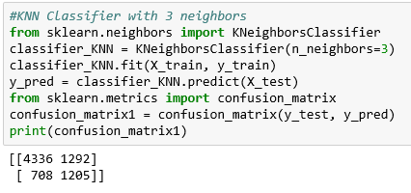
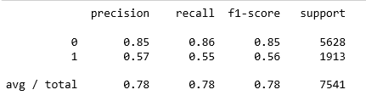
K-NEARSET NEIGHBOURS CLASSIFIER
Compute a distance value between the item to be classified and every item in the training data-set
2. Pick the k closest data points (the items with the k lowest distances)
3. Conduct a “majority vote” among those data points — the dominating classification in that pool is decided as the final classification
Accuracy of KNN classifier on test set: 0.73

Slide 9
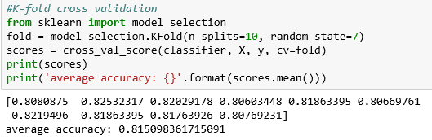
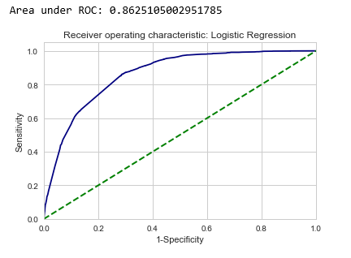
K-fold cross validation
Accuracy on K-FOLD Cross Validation: 0.815
ROC CURVE
Area under the curve : 0.865
The AUC is the area under the ROC curve.
This score gives us a good idea of how well the model performances.

Slide 10
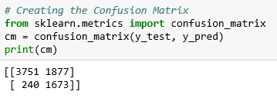
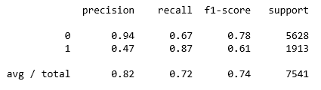
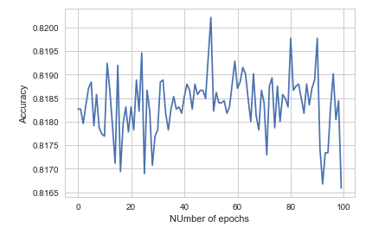
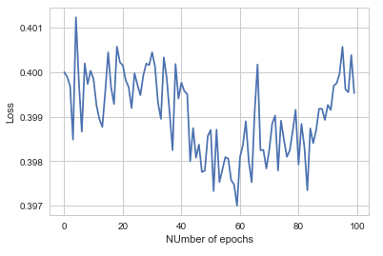
Neural Networks
Accuracy of Neural network classifier on test set: 0.825

Slide 11
Results
Algorithm | Accuracy
Logistic Regression | 81
S | 81
K-Nearest Neighbors Classifier | 73
Neural Networks | 82.5

Slide 12
References
https://archive.ics.uci.edu/ml/datasets/adult

